Slide 1

CoolTouchShirts
Learn SQL from Scratch
Anita McSwane-Williams
July 29, 2018

Slide 2
Table of Contents
Get familiar with CoolTShirts
What is the user journey?
Optimize the campaign budget
Extras

Slide 3
1.0 Get familiar with CoolTouchShirts
CoolTouchShirts is a B to C company supplying novelty clothing through online sales
Sales opportunities are generated through online marketing campaigns (utm_campaign) including;
Search Engine Optimization
Pay Per Click
E-mail
Content Marketing etc.
Clients interact with marketing campaigns through sources (utm_sources) i.e.,
Google
Newsletter
Facebook ads etc.
CoolTouchShirts currently has eight marketing campaigns, attributed to six sources outlined in the table on the right
Campaigns | Sources
8 | 6
Campaign | Source
getting – to know-cool-tshirts | nytimes
weekly-newsletter | email
ten-crazy-cool-tshirts-facts | buzzfeed
retargeting-campaign | email
retargeting-ad | facebook
interview-with-cool-tshirts-founder | medium
paid-search | google
cool-tshirts-search | google

Slide 4
1.1 Get familiar with CoolTouchShirts - Funnel
The graphic on the right represents the typical CoolTshirts customer journey towards a purchase with a count of visits to each page by distinct user_id.
CoolTouchShirts funnel starts with a landing page, which is the first page a customer would interact with coming from a marketing campaign
Customers who move through the funnel and make it to purchase are considered converted from an opportunity to a sale
Here we can see that 361 out of 1,979 unique visits converted into a sale
1 - landing_page 1,979
2 - shopping_cart 1,881
3 – checkout 1,431
4 – purchase
361

Slide 5
2.0 What is the user Journey – First Touch
We can understand how the different campaigns drive conversion by tying them to the customers journey through the funnel
First touch attribution helps us know how visitors are initially discovering the website, and assigns all credit to the first source the customer engaged with
The table on the right shows us which campaigns are a first touch for CoolTShirt customers, and how many first touches can be attributed to the campaign
Only four of the eight campaigns are a first touch for CoolTshirt customers
Stories introducing the company provide more opportunities than search, this could mean brand awareness needs to be built up in the segment and/or additional search terms should be explored
Campaign | First Touch
interview-with-cool-tshirts-founder | 622
getting – to know-cool-tshirts | 612
ten-crazy-cool-tshirts-facts | 576
cool-tshirts-search | 169

Slide 6
2.1 What is the user Journey – Last Touch
Last touch attribution assigns all credit to the last source the customer engaged with
The table on the right shows us which campaigns are a last touch for CoolTShirt customers, and how many last touches can be attributed to the campaign
All eight of the campaigns are a last touch for CoolTshirt customers, this makes logical sense as a first touch can also be a last touch if a customer never left the funnel and interacted with a different source before making a purchase
Once again search campaigns bring the fewest opportunities
Campaign | LastTouch
weekly-newsletter | 447
retargeting-ad | 443
retargeting-campaign | 245
getting – to know-cool-tshirts | 232
ten-crazy-cool-tshirts-facts | 190
interview-with-cool-tshirts-founder | 184
paid-search | 178
cool-tshirts-search | 60

Slide 7
2.1 What is the user Journey - Purchase
Finally out of a total of 1979 opportunities 361 purchases were made
We can use the information from the purchase page in the funnel combined with the last touch information, to understand how many purchases can be attributed to the campaigns
This data confirms what we saw in the first and last touch analyses, customers seem to have an affinity to the company story which drives their decision to engage and as we see here purchase
Campaign | LastTouch
weekly-newsletter | 114
retargeting-ad | 112
retargeting-campaign | 53
paid-search | 52
getting – to know-cool-tshirts | 9
ten-crazy-cool-tshirts-facts | 9
interview-with-cool-tshirts-founder | 7
cool-tshirts-search | 2

Slide 8
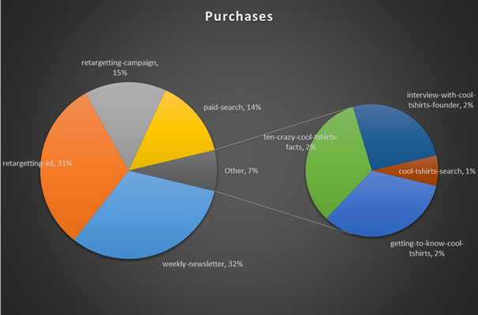
3.0 Optimize the campaign budget
18% of all opportunities converted into a purchase
32% of purchases are attributed to the weekly newsletter campaign whose source is e-mail
The next best campaign is retargeting-ad, which 31% of purchases can be attributed to. The source of this campaign is facebook

Slide 9
3.1 Optimize the campaign budget
CoolTshirts can re-invest in 5 campaigns
The top 5 performing campaigns by opportunities, purchases, and conversion are below. Conversion is calculated based on last touch attribution.
Campaign | Touches
interview-with-cool-tshirts-founder | 622
getting – to know-cool-tshirts | 612
ten-crazy-cool-tshirts-facts | 576
weekly-newsletter | 447
retargeting-ad | 443
Campaign | Purchases
weekly-newsletter | 115
retargeting-ad | 113
retargeting-campaign | 54
getting – to know-cool-tshirts | 52
interview-with-cool-tshirts-founder | 9
Campaign | Conversion
weekly-newsletter | 26%
retargeting-ad | 26%
retargeting-campaign | 22%
getting – to know-cool-tshirts | 22%
interview-with-cool-tshirts-founder | 5%
Based on these data points it is easy to identify weekly-newsletter, retargeting-ad, and getting-to know-cool-tshirts for re-investment. All three drive high touch, and customers who interact with these campaigns convert at high rates.

Slide 10
3.2 Optimize the campaign budget
We have already chosen 3 of our 5 campaigns bolded below
For the fourth campaign CoolTShirts will choose retargeting-campaign. Although this campaign is not the highest in touch, the overall % of purchases is 3rd highest and conversion is strong.
Source | Campaign | FirstTouch | % of Total | LastTouch | % of Total | Purchases | % of Purchases | Conversion
medium | interview-with-cool-tshirts-founder | 622 | 31% | 184 | 9% | 9 | 2.5% | 4.9%
nytimes | getting – to know-cool-tshirts | 612 | 31% | 232 | 12% | 52 | 14% | 22%
buzzfeed | ten-crazy-cool-tshirts-facts | 576 | 29% | 190 | 10% | 9 | 2.5% | 4.7%
google | cool-tshirts-search | 169 | 9% | 60 | 3% | 2 | 1% | 3%
email | weekly-newsletter |  |  | 447 | 23% | 115 | 32% | 26%
facebook | retargeting-ad |  |  | 443 | 22% | 113 | 31% | 26%
email | retargeting-campaign |  |  | 245 | 12% | 54 | 15% | 22%
google | paid-search |  |  | 178 | 9% | 7 | 2% | 3.9%
Total |  | 1979 |  | 1979 |  | 361

Slide 11
3.2 Optimize the campaign budget
For the 5th campaign we should take a step back and do a bit more digging into the data.
Between Interview-with-cool-tshirts-founder (ICTF) and ten-crazy-cool-tshirts-facts (10) we have high first touch with low purchase volume.
10 campaign had more user impressions at 648 versus ICTFs 625
In this case I would suggest looking at the following. What does the first touch attribution calculation look like? Who wins overall conversion with that metric?
In the end I would not leave money on the table by dropping either campaign, I would invest in retargeting for these two high touch campaigns.
Source | Campaign | FirstTouch | % of Total | LastTouch | % of Total | Purchases | % of Purchases | Conversion
medium | interview-with-cool-tshirts-founder | 622 | 31% | 184 | 9% | 9 | 2.5% | 4.9%
nytimes | getting – to know-cool-tshirts | 612 | 31% | 232 | 12% | 52 | 14% | 22%
buzzfeed | ten-crazy-cool-tshirts-facts | 576 | 29% | 190 | 10% | 9 | 2.5% | 4.7%
google | cool-tshirts-search | 169 | 9% | 60 | 3% | 2 | 1% | 3%
email | weekly-newsletter |  |  | 447 | 23% | 115 | 32% | 26%
facebook | retargeting-ad |  |  | 443 | 22% | 113 | 31% | 26%
email | retargeting-campaign |  |  | 245 | 12% | 54 | 15% | 22%
google | paid-search |  |  | 178 | 9% | 7 | 2% | 3.9%
Total |  | 1979 |  | 1979 |  | 361

Slide 12
Extras
CoolTshirts database schema
SQL Code

Slide 13
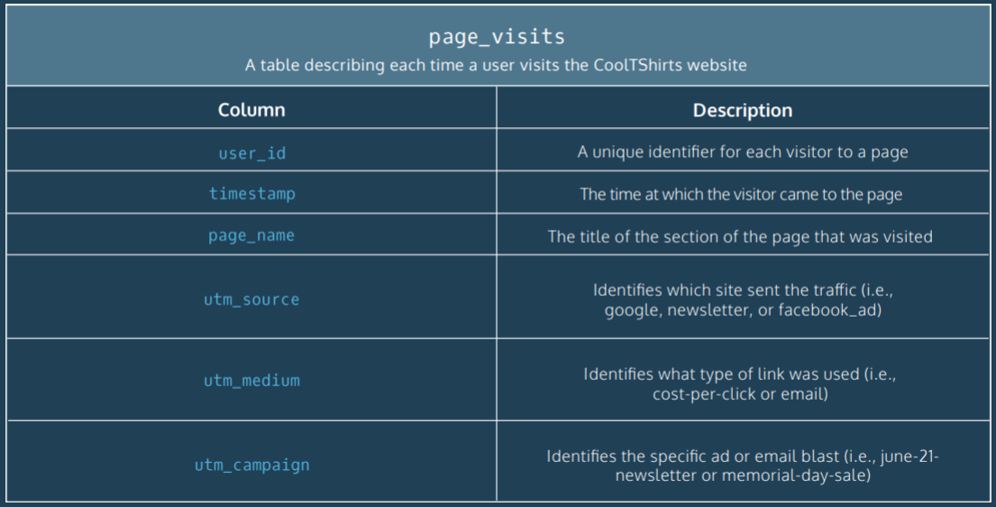
Database Schema

Slide 14
SQL Code
SELECT COUNT(DISTINCT utm_campaign)
FROM page_visits;
SELECT COUNT(DISTINCT utm_source)
FROM page_visits;
SELECT DISTINCT utm_campaign,
utm_source
FROM page_visits;
SELECT DISTINCT page_name
FROM page_visits;
1. Get familiar with the company.
How many campaigns and sources does CoolTShirts use and how are they related? Be sure to explain the difference between utm_campaign and utm_source.
What pages are on their website?

Slide 15
SQL Code
WITH first_touch AS (
SELECT user_id,
MIN(timestamp) AS first_touch_at
FROM page_visits
GROUP BY user_id)
SELECT pv.utm_campaign,
COUNT(ft.first_touch_at) AS FirstTouch
FROM first_touch ft
JOIN page_visits pv
ON ft.user_id = pv.user_id
AND ft.first_touch_at = pv.timestamp
GROUP BY 1
ORDER BY 2;
WITH last_touch AS (
SELECT user_id,
MAX(timestamp) AS last_touch_at
FROM page_visits
GROUP BY user_id)
SELECT pv.utm_campaign,
COUNT(lt.last_touch_at) AS lastTouch
FROM last_touch lt
JOIN page_visits pv
ON lt.user_id = pv.user_id
AND lt.last_touch_at = pv.timestamp
GROUP BY 1
ORDER BY 2;
2. What is the user journey?
How many first touches is each campaign responsible for?
How many last touches is each campaign responsible for?

Slide 16
SQL Code
SELECT COUNT(DISTINCT user_id)
FROM page_visits
WHERE page_name = '4 - purchase';
WITH last_touch AS (
SELECT user_id,
MAX(timestamp) AS last_touch_at
FROM page_visits
WHERE page_name = '4 - purchase'
GROUP BY user_id)
SELECT pv.utm_campaign,
COUNT(lt.last_touch_at) AS lastTouch
FROM last_touch lt
JOIN page_visits pv
ON lt.user_id = pv.user_id
AND lt.last_touch_at = pv.timestamp
GROUP BY 1
ORDER BY 2 DESC;
2. What is the user journey?
How many visitors make a purchase?
How many last touches on the purchase page is each campaign responsible for?
What is the typical user journey?

